Slide 1

Rareities Inventory System
By Prevailer Mba

Slide 2
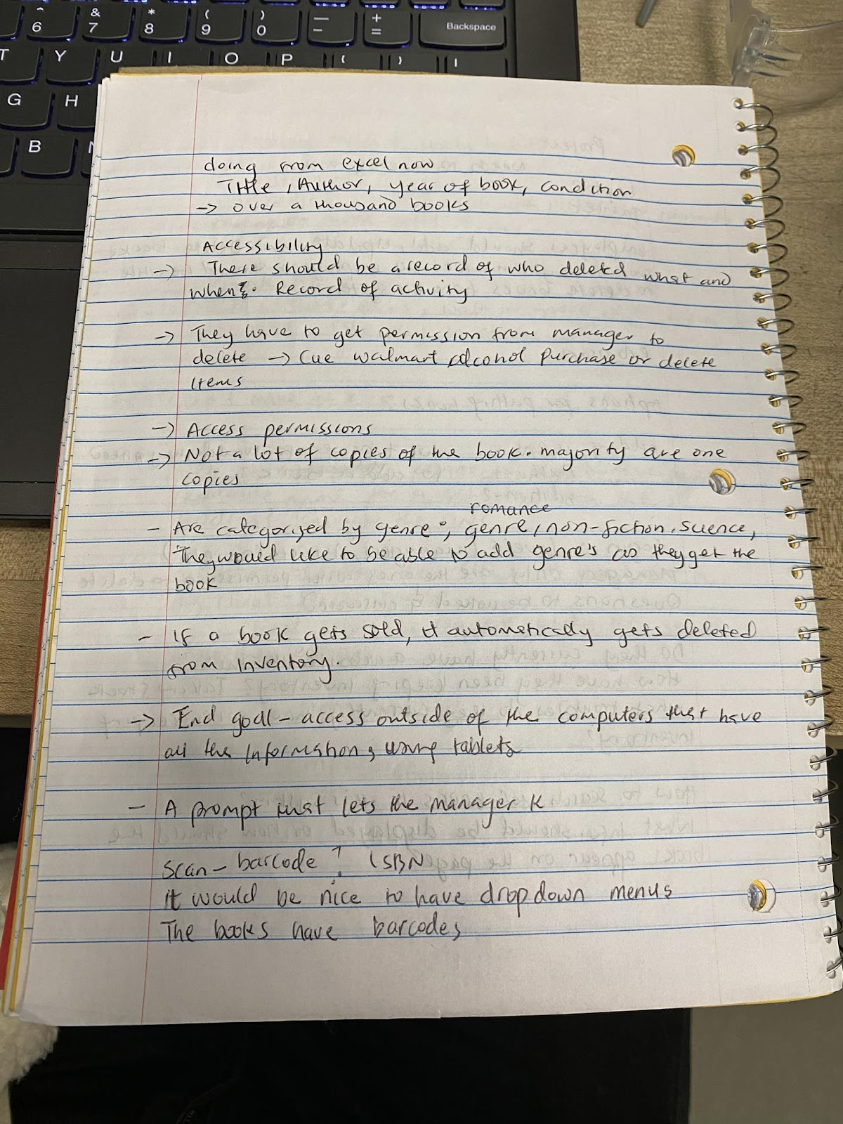
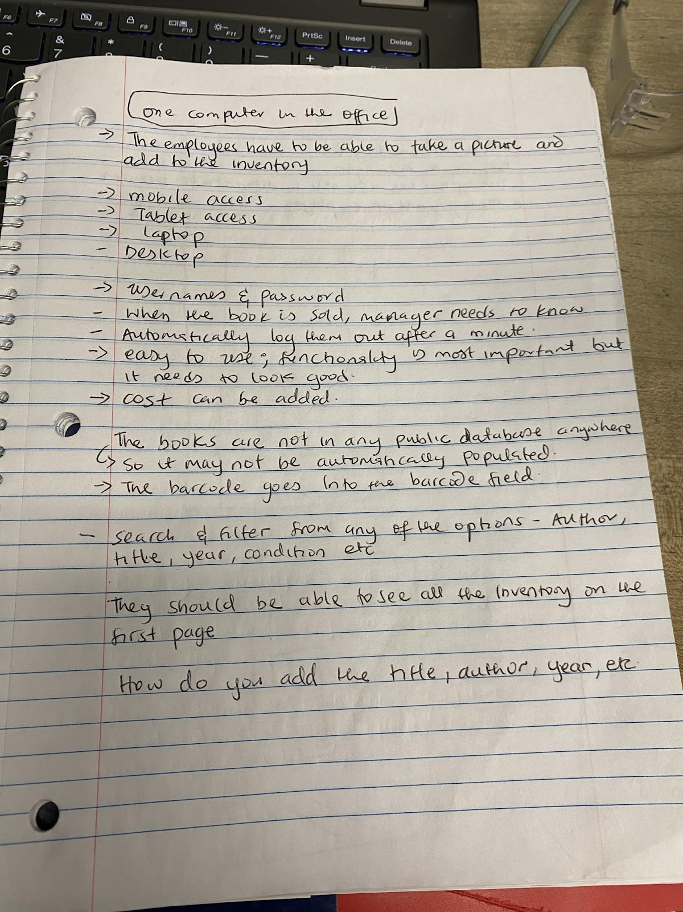
Empathize
Summary of information gathered:
Bookstore employees currently use an excel file to login books
It takes a while to put information into the excel file because they have to manually type in the book information.
They have had issues in the past with employees mistakenly deleting books from the excel file.
They do not currently have a way of tracking when updates are made to the excel file.
They have to manually delete books from the excel file after the books have been sold.
They have one computer in the office which makes it difficult for everyone to login books when they want.

Slide 3
Define
For Jonathan (A Persona):
Create a system that will reduce the amount of time he spends putting new books into the system. He should not have to manually type in book information.
He should be able to search for books in one or two steps.
He should be able to add, update, and filter books by certain criteria such as publication year.
For Jennifer and Onyinyechi (Personas):
Create a system that will give only Jennifer the access to delete books.
Jennifer should be able to get real-time notifications when books are added, updated, sold, and number of copies left in inventory. She also has to be able to search for books quickly.
Onyinyechi needs a system that can automatically generate an analytics report based on the time period that she desires to look at.

Slide 4
Ideate
Conducted a brainstorming session with Joy and came up with two ideas, Idea1 and Idea2.
Idea1 requests a username and password for the user and submits the information for validation. After that, it links to the next page which is the inventory page. Idea1 inventory includes a column for all genres that the bookstore offers and another column for the books and their info. Each book then features a set of options such as update and delete. The delete button will only be visible on the manager’s screen. There is also a search, add, and filter button at the top.
Idea2 includes a login and inventory page as well. The login page requests the badge number, username, and password from the user to log them into the system. The badge number is used to differentiate between a manager and an associate. The submit button links to the next page which is the inventory page. The inventory page includes a search bar, a genre dropdown menu, a filter button, and the rest of the screen is supposed to show multiple books at once including a snapshot of the book information. Clicking on the book image takes the user to another page showing more information about the book and includes an update and delete button. Only managers will be able to see the delete button.

Slide 5
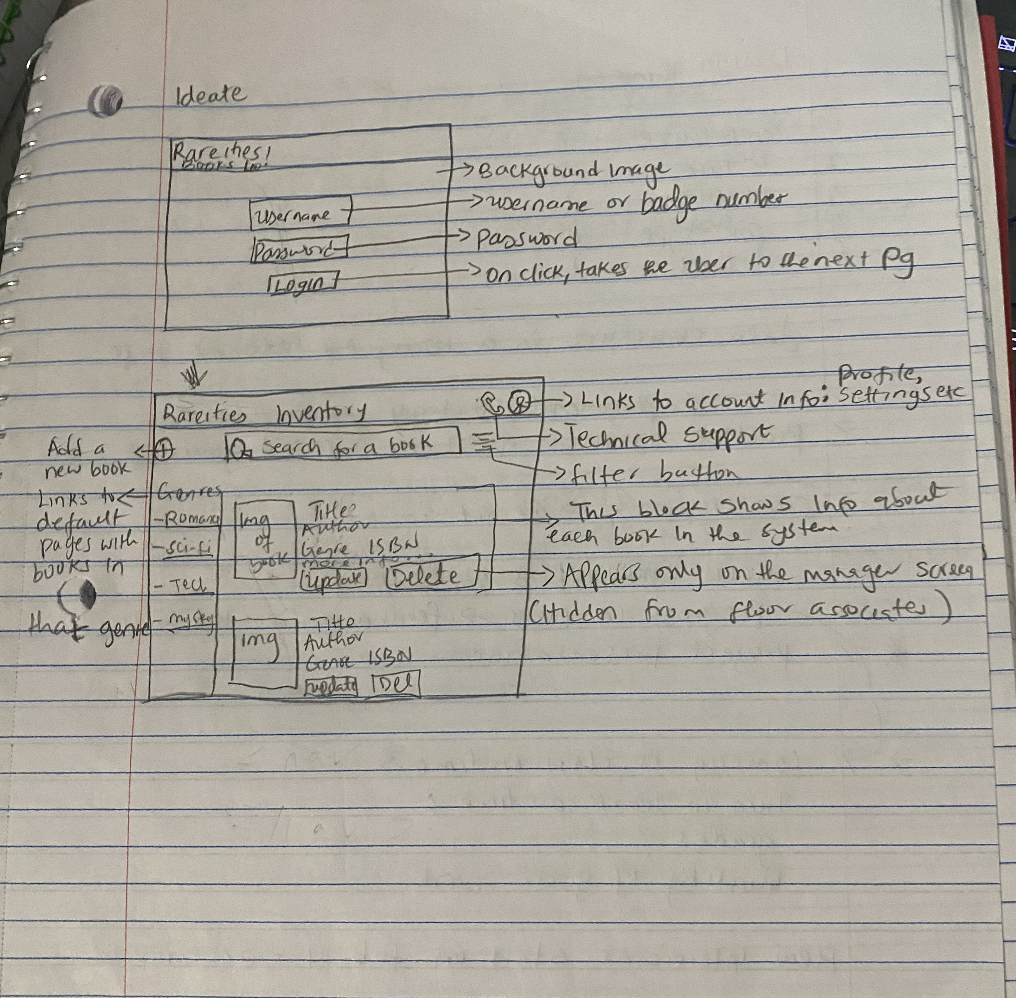
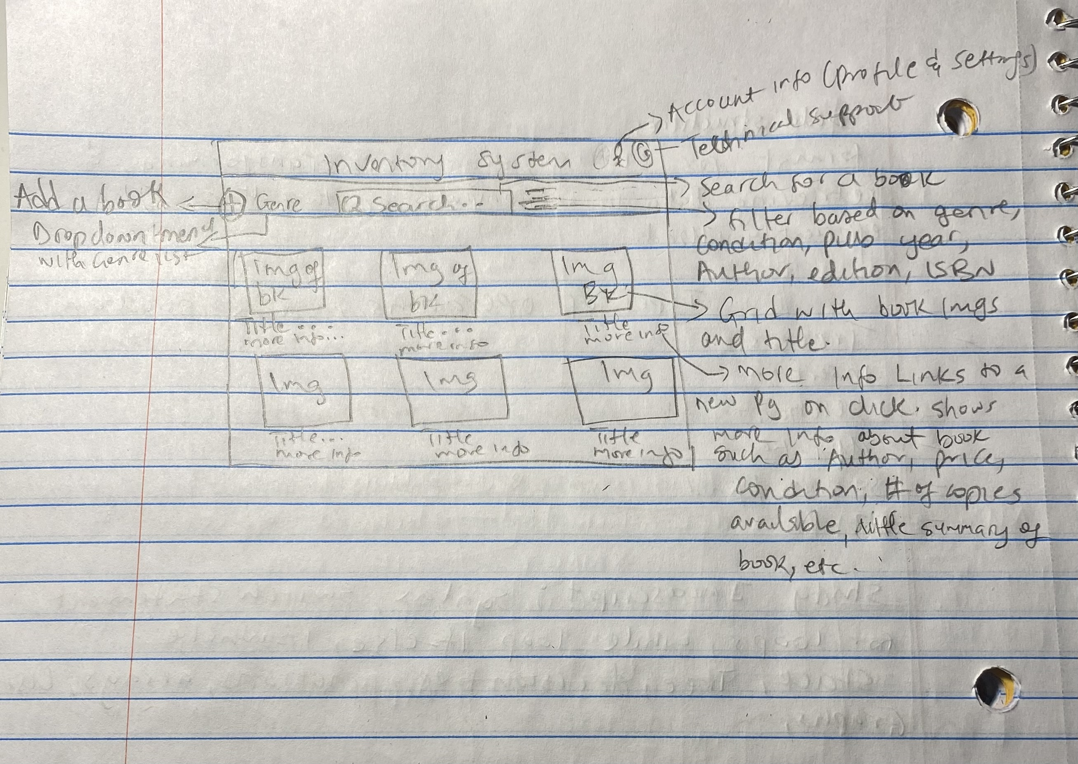
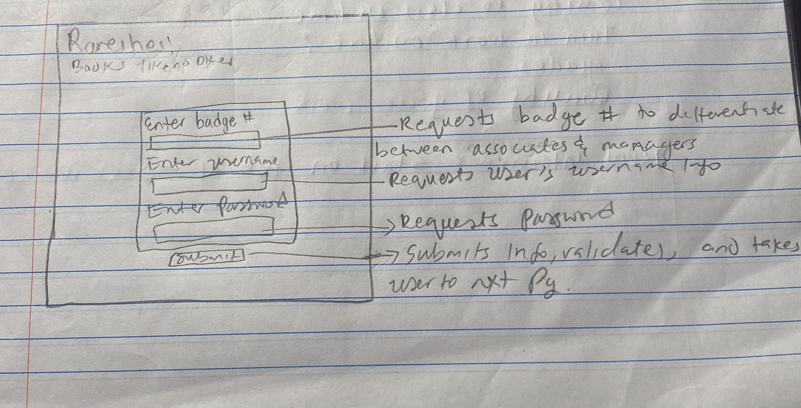
Prototype
Idea1 – Login and Inventory Page
Idea2 – Inventory Page
Idea2 – Login Page

Slide 6
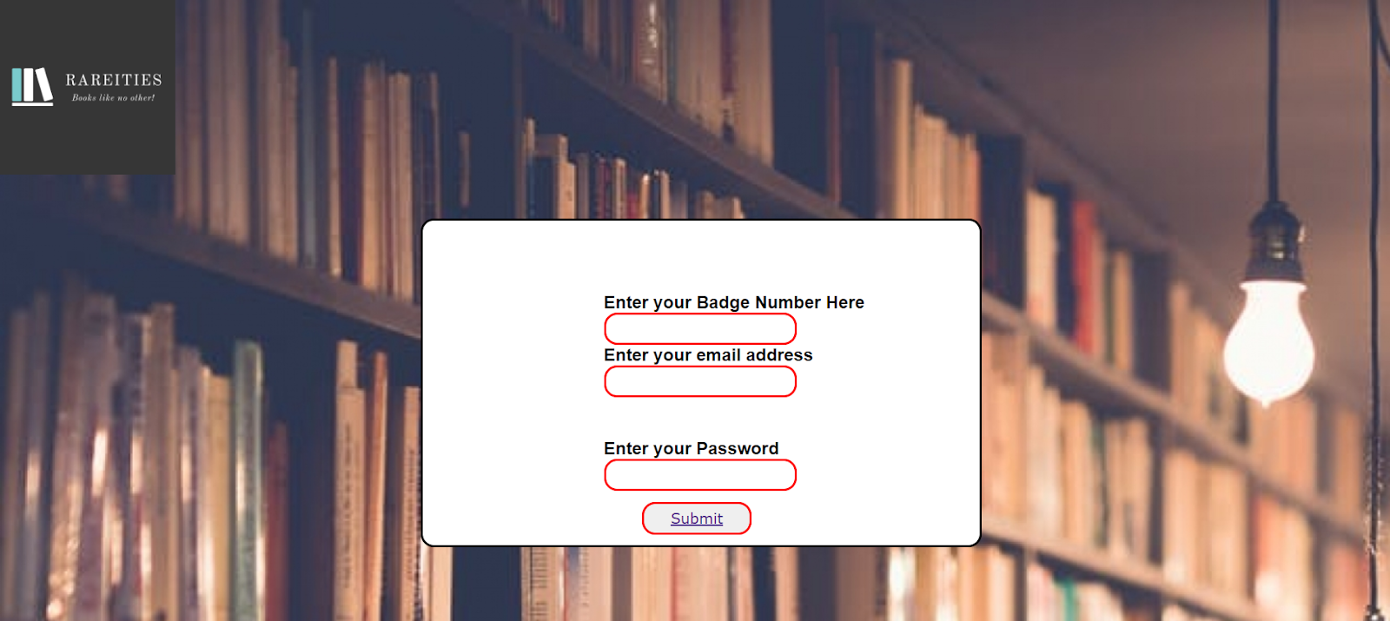
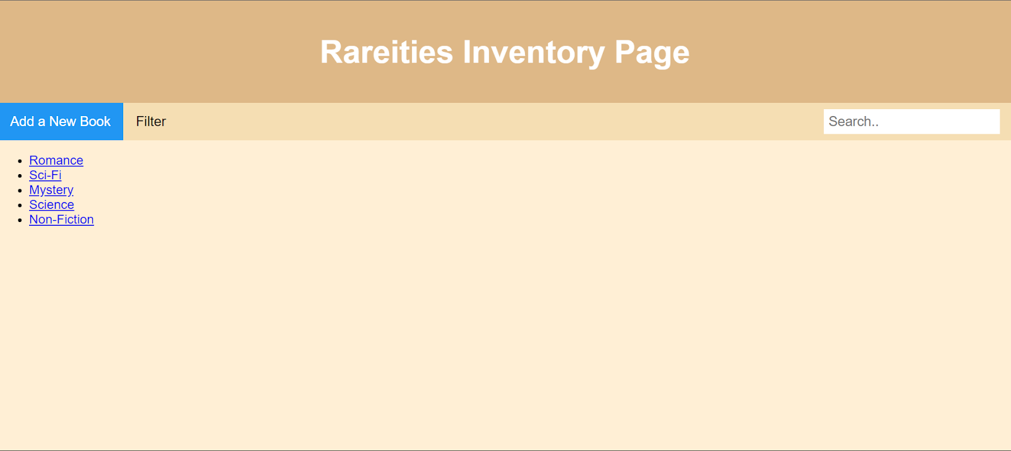
Test
Still a work in progress
A classmate tested the login page and pointed out that there’s no forgot password and no new user(create account) option.

